Slide 1

Memory Management in Python
Jatin Goel @_JatinGoel

Slide 2

What is Memory Management?
Why should I care?
Notes:
Why Should I care? – Who here have done some competitive programming and faced MLE errors?
Do you know why that happens?
It helps you write more efficient code

Slide 3

Variables

Slide 4
Variables contd.
C-Style variable
int a = 5;
Int b = 10;
Fix size, same type
variable | location | value
a | 0x3ab | 0101
b | 0x3ac | 1010

Slide 5
Variables contd.
// later
a = 15;
variable | location | value
a | 0x3ab | 1111
b | 0x3ac | 1010
Value is updated
Really, what does that mean?
Notes:
Data in the memory location is overwritten

Slide 6
Types of variables in python
How many?
None
Yes, you heard read that right..

Slide 7
Let’s rewind back…
Everything Is an Object
Python has Names
names references objects
Notes:
Name is just a label for an object
An object can have a lot of names

Slide 8
objects
Container objects can contain Simple objects or other container objects.
Simple | Containers
numbers | dict
strings | list
 | user defined classes

Slide 9
How are objects stored in Python?
Stacks and Heaps
Stack is used for storing all the variables, functions, etc.
Heap is used for storing the actual values / data

Slide 10


References – what does that mean…?
A name or container object that points at another object
Reference Count

Slide 11
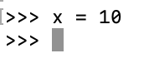
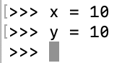
References
10
refs to value 10: 1
+1
x
10
+1
refs to value 10: 2
+1
x
y

Slide 12
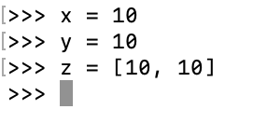
References contd.
10
+2
+1
refs to value 10: 4
+1
x
y

Slide 13
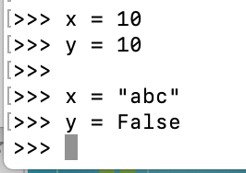
References contd. – Decrease the Ref count
Change the Reference
10
-1
Removed the 2 refs to 10
-1
x
y
Notes:
So far, we increased the reference count, how do we decrease it?

Slide 14
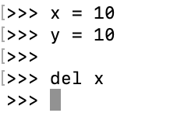
References contd. – Decrease the Ref count
Use del keyword
But what does del actually do?
Well for one, it does not delete objects
It only removes the name as a reference to the object – hence reduces the ref count by 1
10
-1
Decreases refs to 10 by 1
-1
x
y

Slide 15
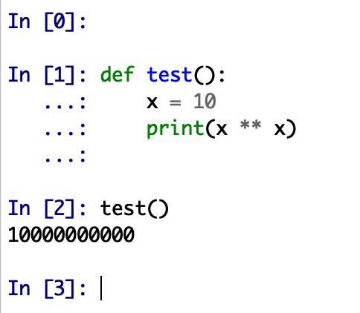
References contd. – Decrease the Ref count
Go out of scope
ref count of object with value 10: +1
ref count -1
object with value 10 out of scope

Slide 16
References
What happens when there are no references to an object?
Yes, you guessed it right.
It can now be safely removed from the memory.

Slide 17
Moment of Zen
Local VS Global Namespace
What happens to objects created in global namespace?
Never goes out of scope
Refcount never reaches 0
Avoid putting large or complex objects in the global namespace

Slide 18
Python objects
PyObject
type | integer
refcount | 2
value | 10
We said everything is an object. So what does it look like and what does it store?
Every Python object holds 3 things
Type
Reference count
Value

Slide 19
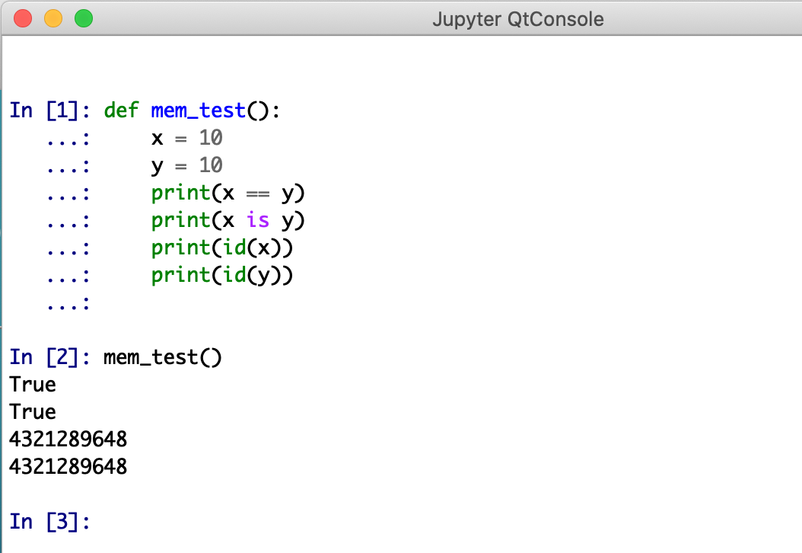
Proof of Concept
2 Names
2 References
1 Object in memory
x
y
type | integer
refcount | 2
value | 10
Notes:
This is called interning, where Python points immutable objects (int and str) with same value to same memory location
Python does this by default as Memory Optimization

Slide 20
Interning
Point immutable objects (int / str) with same value to same memory location
Python does this by default as Memory Optimization
But what if I want to intern some complex repetitive strings myself?
Python’s sys module has the .intern() function

Slide 21
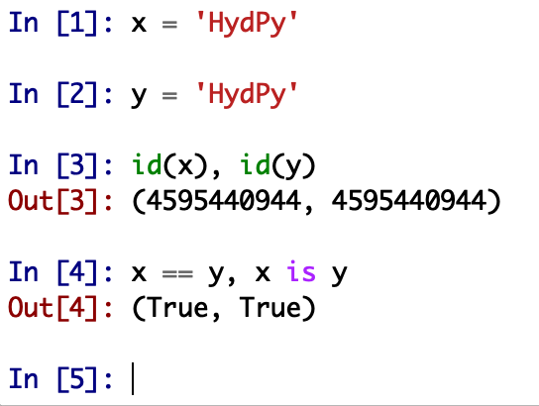
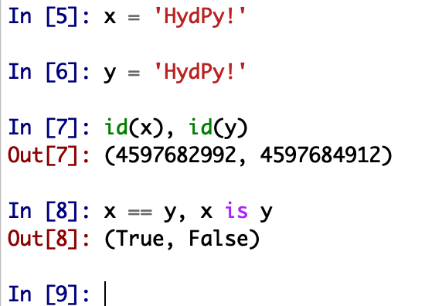
Interning
Notes:
Due to encoding of each character the resultant id could be different, Out of scope for this topic

Slide 22
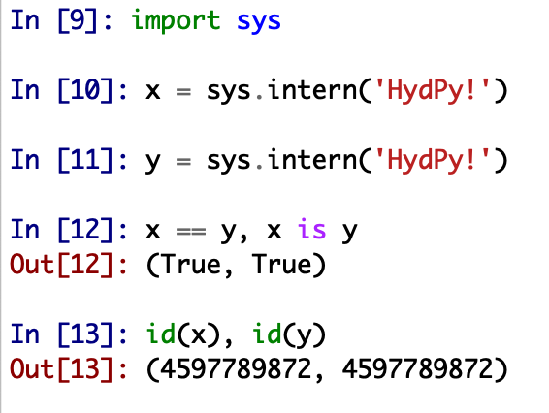
Interning
Pros
Reduces the overall memory of the program
Cons
CPU overhead
Use only when there are a lot of repetitive strings
If there are no repetitive strings, you may end up creating more memory than you need

Slide 23

Garbage collection

Slide 24
Garbage collection
What is Garbage collection?
Way for a program to automatically release memory when object taking up that space is no longer in use
Types of Garbage collection-
Reference Counting
Tracing

Slide 25
Reference counting garbage collection
Add or remove references
Remove the object from memory when the refcount reaches 0
Does that only remove that object – No
Cascading effect
decrease ref count of any object the deleted object was pointing to

Slide 26
Reference counting garbage collection
The Good
Easy to implement
Objects are immediately deleted when ref count reaches 0
The BAD
space overhead – refcount is stored for every object
execution overhead – need to update the refcount on every assignment

Slide 27
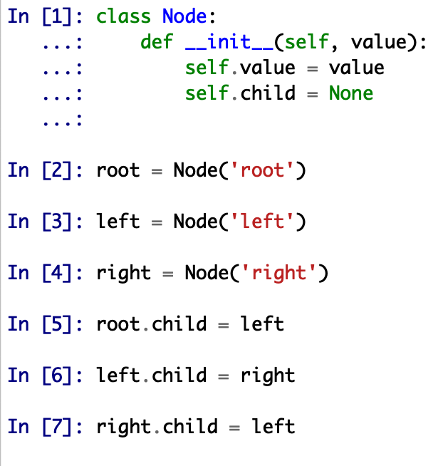
Reference counting garbage collection
The Challenges or the Ugly side to it
Does not detect Cyclical references
root
rc = 1
left
right
rc = 3
rc = 2

Slide 28
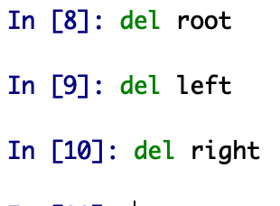
Cyclical References
Reference to root is deleted, hence rc becomes 0
Since root is deleted, its child, i.e., reference to left is decreased by 1
Reference counting garbage collection alone will not help
root
rc = 0
left
right
rc = 1
rc = 1

Slide 29
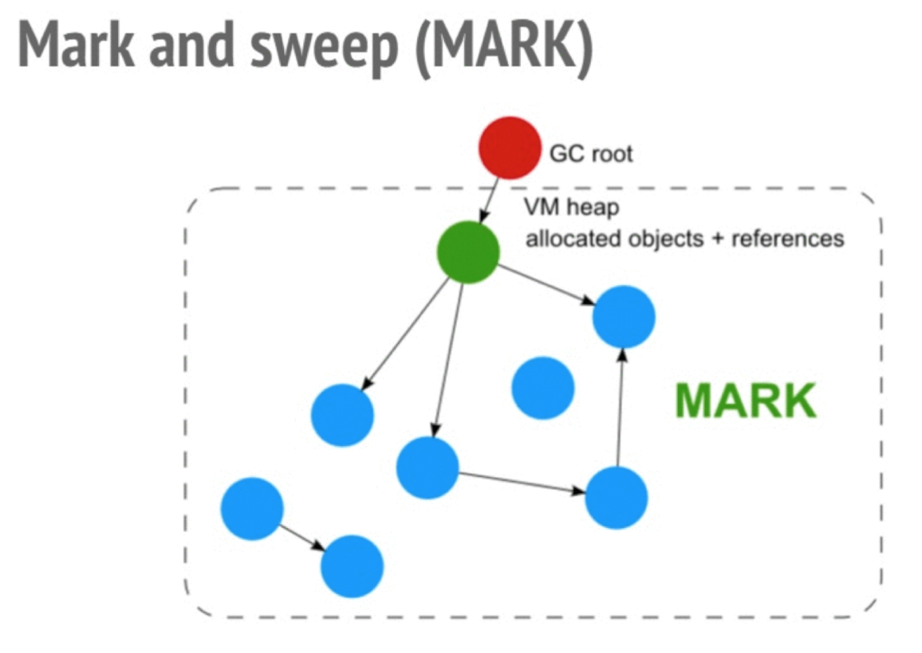
Tracing Garbage Collection
Uses Mark and Sweep Algorithm
Marking

Slide 30
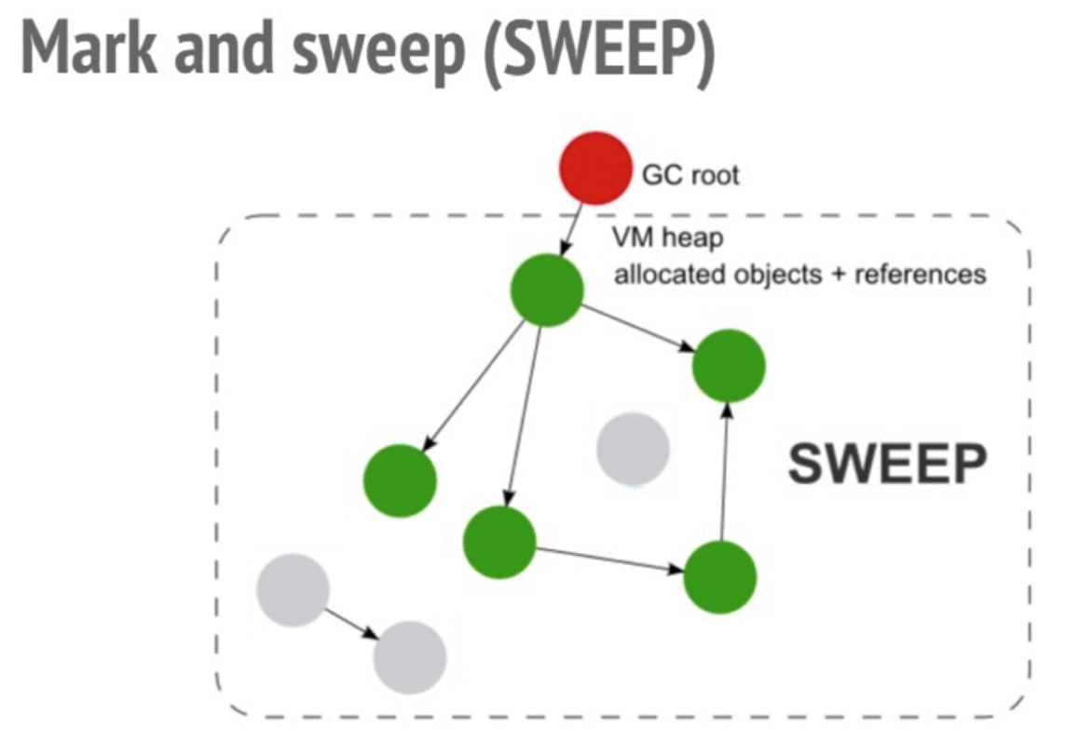
Tracing Garbage Collection
Uses Mark and Sweep Algorithm
Sweeping

Slide 31
What does Python Use?
Reference Counting
Generational (A type of Tracing GC)

Slide 32
Generational Garbage Collection
Based on the theory that most objects die young
Python maintains 3 lists of every object created as a program is run
generation 0
generation 1
generation 2
Newly created objects are stored in generation 0

Slide 33

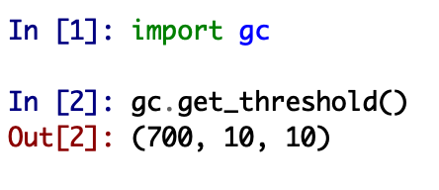
Generational Garbage Collection
Only container objects with a refcount greater than 0 will be stored in a generation list
When the number of objects reaches a threshold, Python runs a GC algorithm on that generation and any generations younger than it

Slide 34
Generational Garbage Collection Cycle
Python makes a list of objects to be discard
Runs the algorithm to detect reference cycles
If an object has no outside references, add it to the discard list
When the cycle is done, free up the objects on the discard list
Repeat above steps for any younger generations

Slide 35
Generational Garbage Collection Cycle
After the cycle finishes, it promotes the surviving objects to the next generation
Objects in the last generation (generation 2) stay as the program executes
When ref count reaches 0, object gets cleaned up immediately
If there are any cyclic references, you need to wait for GC to run

Slide 36
The Big Question
Why doesn’t a Python program shrink in memory after garbage collection?

Slide 37
Fragmentation – Not what you think..
Yes, the size of the Python program likely won’t shrink
The memory is not freed up from continuous block, rather it is fragmented
The memory freed up during GC is released back to Python to use for other objects, not necessarily to the system

Slide 38

Quick Optimizations

Slide 39
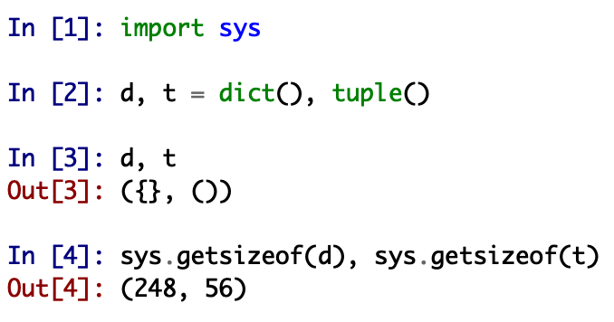
dict vs tuple

Slide 40
__slots__

Slide 41
When to use __slots__?
Creating many instances of a class
Know in advance what properties the class should have
__slots__ gives you faster attribute access
Further reading - http://book.pythontips.com/en/latest/__slots__magic.html

Slide 42
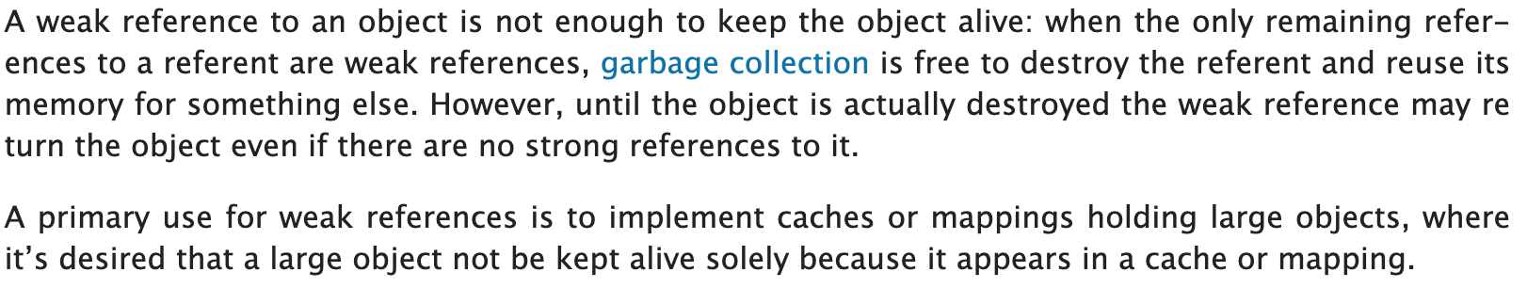
weakref
Add a reference to an object but which is not enough to keep it alive
When the remaining references to an object are all weakref, the object can safely be garbage collected
Useful for implementing caches or mappings holding larger objects
From weakref Python docs:
python3 weakref docs

Slide 43
What did we learn?
Python has names, references, objects
Reference counting Garbage Collection
Tracing Garbage Collection
Generational Garbage Collection (A type of Tracing GC)
Garbage collection is good
Why doesn’t the python program shrink in memory after GC?
__slots__
weakref

Slide 44
Sources
Nina Zakharenko’s talk on same topic – North Bay Python 2018
https://www.youtube.com/watch?v=URNdRl97q_0
Theresa Lee’s talk on same topic – PyGotham 2018
https://www.youtube.com/watch?v=3pXquKQf2qk
Python docs - https://docs.python.org/3/c-api/memory.html
Medium - https://towardsdatascience.com/memory-management-in-python-6bea0c8aecc9
RealPython
And some more sources that I referred long time back but could not find for this slide… ☺

Slide 45
Additional Readings
Python module of the week – gc
Saving 9 GB of RAM with Python’s __slots__
Peephole Optimization - http://akaptur.com/blog/2014/08/02/the-cpython-peephole-optimizer-and-you/
weakref documentation
Artem Golubin’s blog on Python Memory Management

Slide 46

Questions?

Slide 47
What’s next?
Planning a follow up talk on Optimizations in Python
What we’ll cover?
Best Practices
Profiling
Optimizing code

Slide 48
Thank You

